Slide 1
Maths workshop
14.02.22
Fractions

Slide 2
How we teach maths at MPJS…
White Rose Maths
Concrete, Pictorial, Abstract
Fluency, reasoning, problem solving, mastery

Slide 3
What is a fraction?
Children and adults often find fractions difficult
A fraction is a part of a whole.
A whole can be one thing or a group of things.

Slide 4
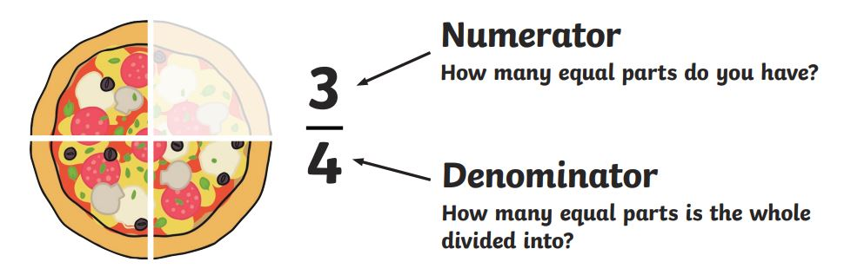
Fractions vocabulary

Slide 5
Fractions vocabulary
Unit fraction: a fraction that has 1 as its numerator. E.g. ¼
Non-unit fraction: a fraction that has a number greater than 1 as its numerator. E.g. ¾

Slide 6
Fractions vocabulary
Proper fraction: a fraction where the numerator is smaller than the denominator. E.g. ⅚
Improper fraction: a fraction where the numerator is larger than the denominator. E.g. 7/5

Slide 7
Fractions vocabulary
Improper fractions can be converted to mixed numbers (a whole and a fraction)
E.g. 7/5 can be converted to 1 whole and ⅖, written as 1 ⅖

Slide 8
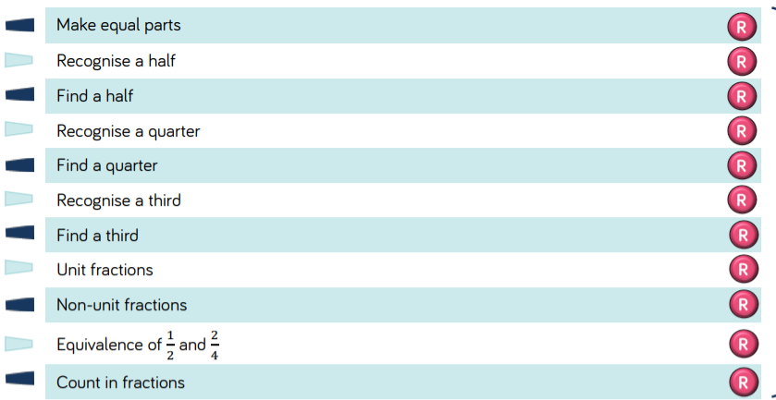
Fractions in Year 3

Slide 9
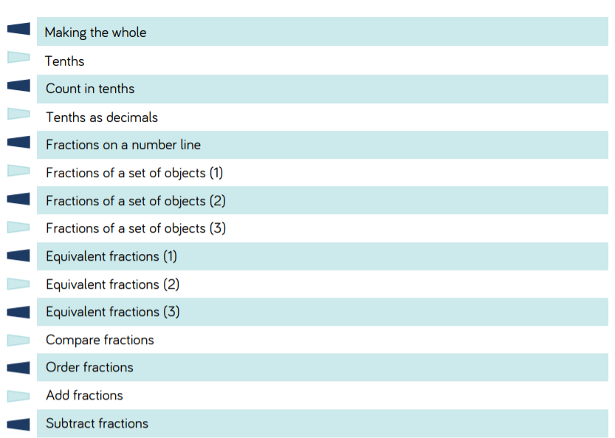
Fractions in Year 3

Slide 10
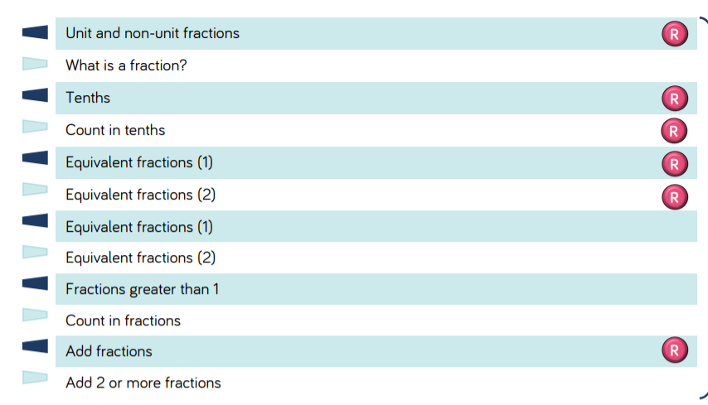
Fractions in Year 4

Slide 11
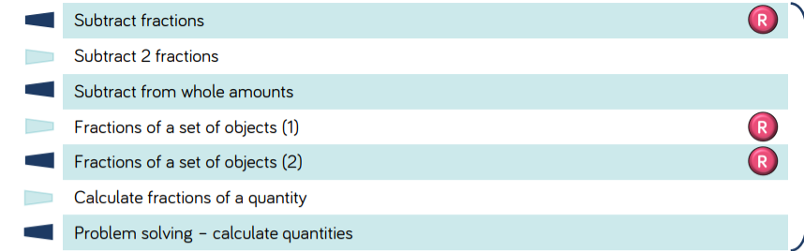
Fractions in Year 4

Slide 12
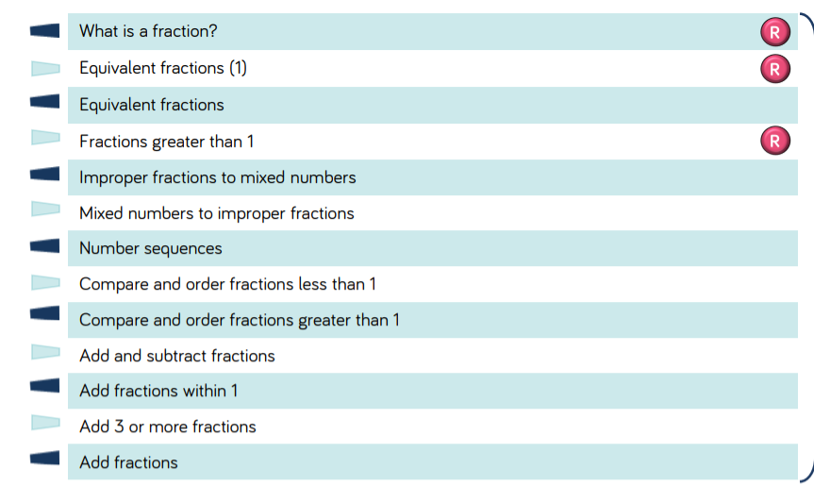
Fractions in Year 5

Slide 13
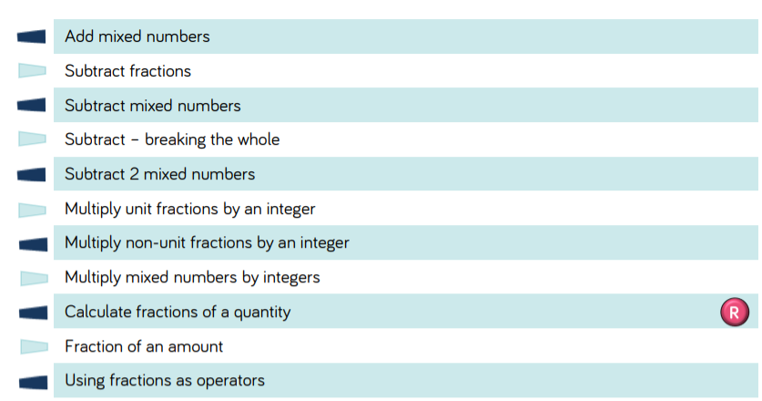
Fractions in Year 5

Slide 14
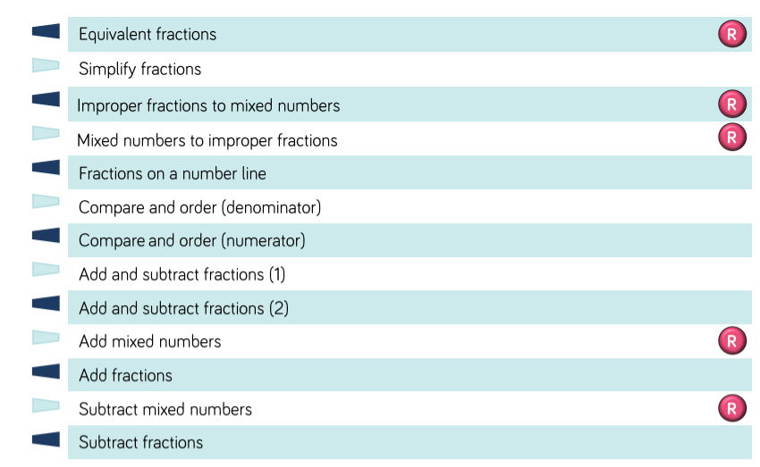
Fractions in Year 6

Slide 15
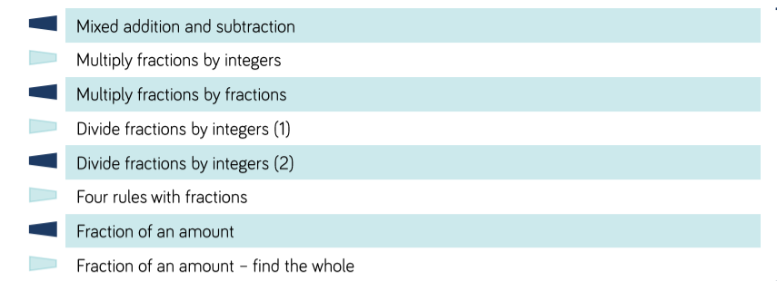
Fractions in Year 6

Slide 16
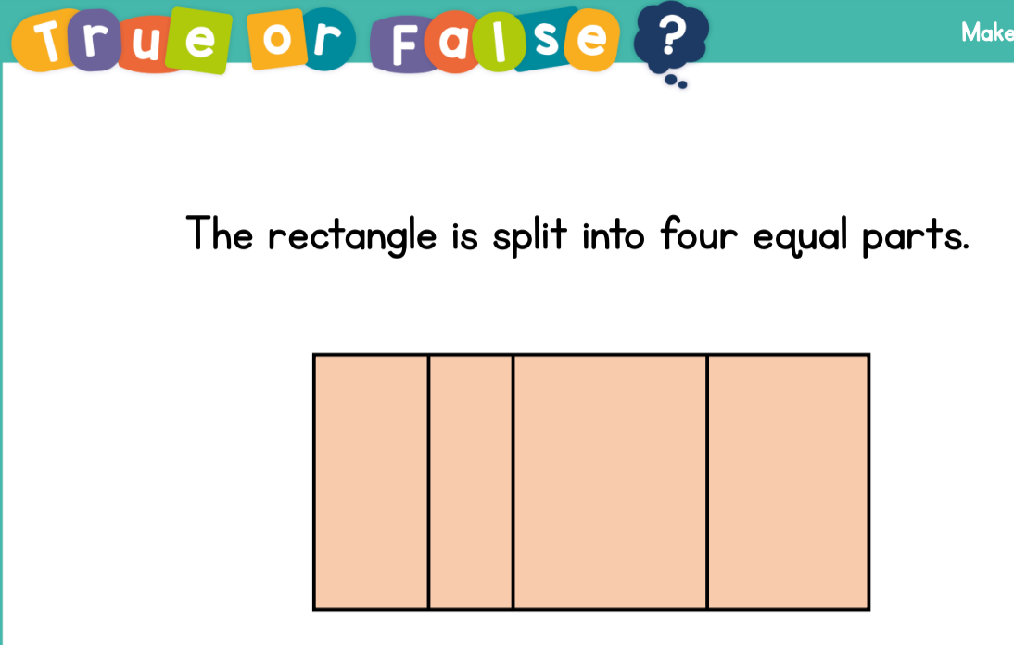
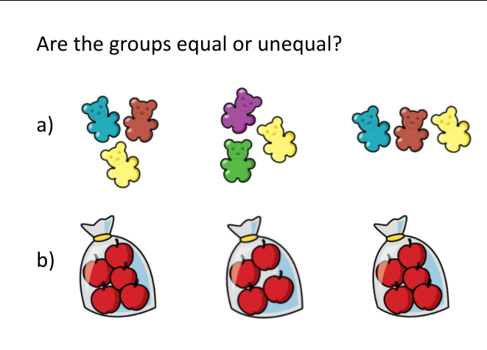
Equal parts
We would start work on fractions by looking at equal parts. Fractions consist of equal groups and children need to understand this.

Slide 17
½
One half
2 equal parts
÷ 2
¼
One quarter
4 equal parts
÷ 4
⅓
One third
3 equal parts
÷ 3

Slide 18
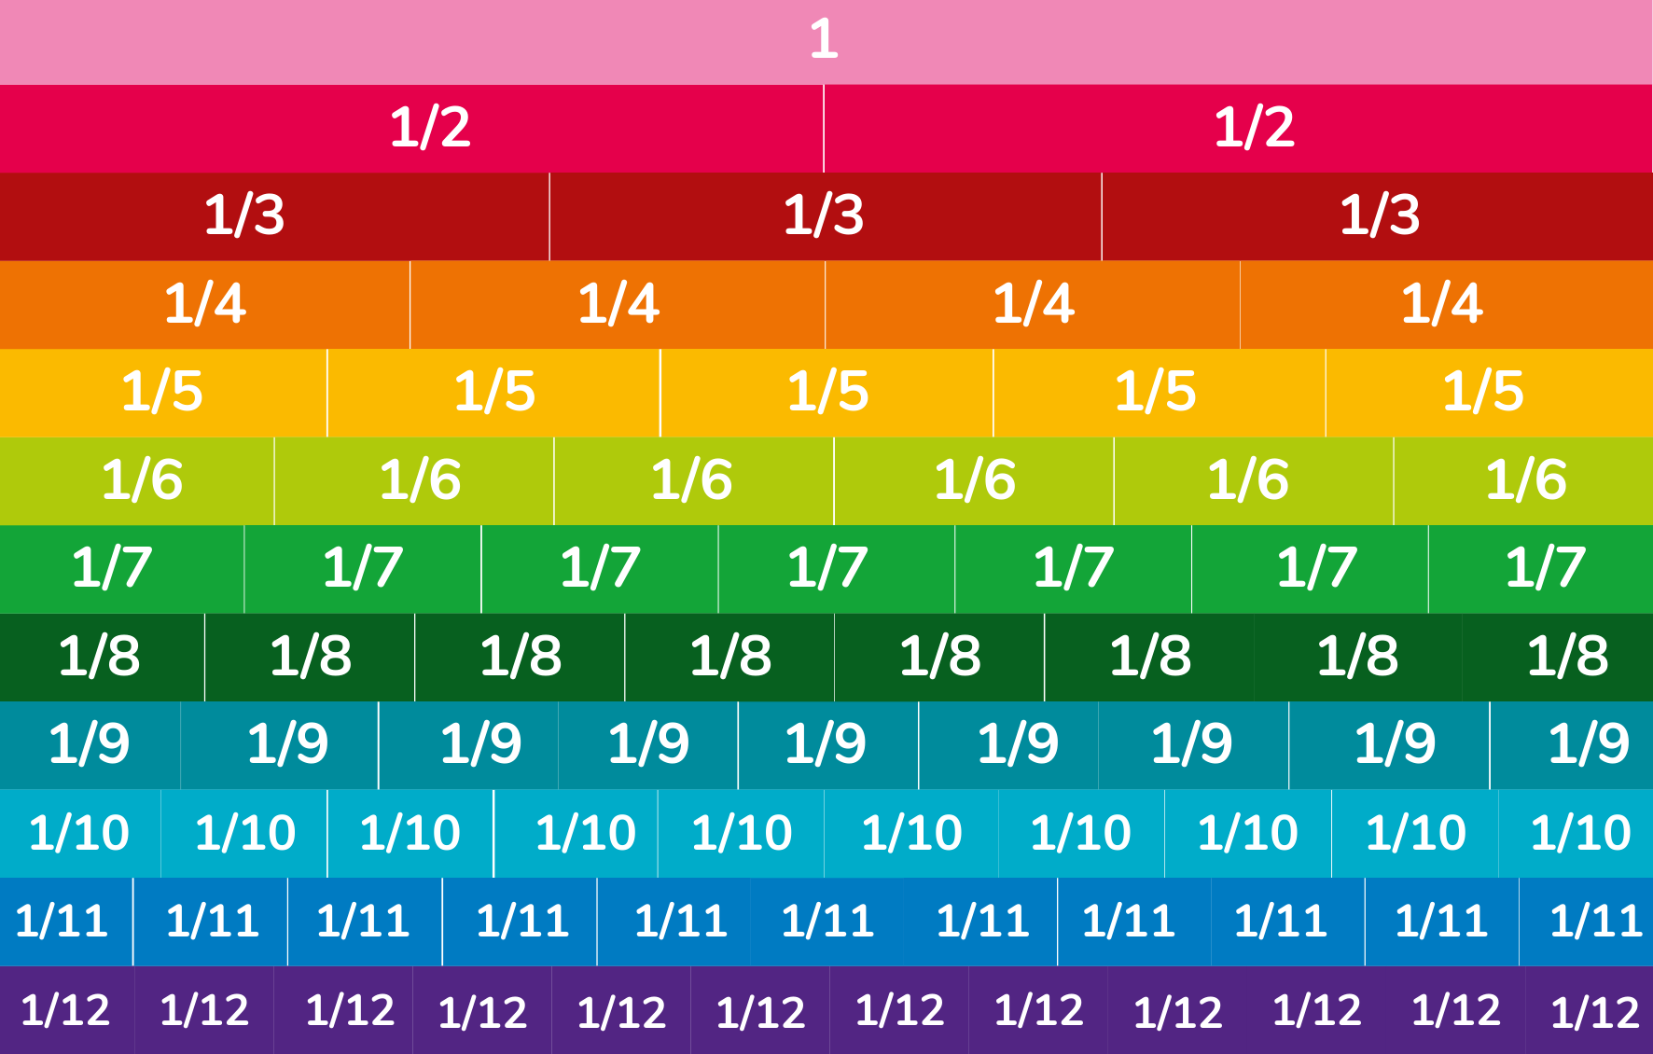
Equivalent fractions
Knowing equivalent fractions will help when ordering and comparing fractions.
Folding paper activity

Slide 19
Adding fractions
When the denominators are the same, just add the numerators.
E.g. 2/8 + 3/8 = ⅝
When the denominators are different, find equivalent fractions. (Year 5)
E.g. ⅚ + ⅔ = ⅚ + 4/6 = 9/6 = 1 3/6 or 1 ½
Whatever you do to the numerator, you do to the denominator!

Slide 20
Subtracting fractions
When the denominators are the same, just subtract the numerators.
E.g. 8/10 - 2/10 = 6/10 or 3/5
When the denominators are different, find equivalent fractions. (Year 5)
E.g. ¾ - ⅜ = 6/8 - ⅜ = ⅜
Whatever you do to the numerator, you do to the denominator!

Slide 21
Simplifying fractions
Divide the fraction down until you can no longer divide it. It will then be in its simplest form.
E.g. 15/30 = 3/ 6 (Divide both the numerator and denominator by 5)= ½ (Divide by 3)
E.g. 45/60 = 9/12 (Divide by 5) = ¾ (divide by 3)
E.g. 12/16 = ¾ (divide by 4)

Slide 22
Multiplying fractions
When multiplying fractions by other fractions, just multiply the denominators and the numerators then simplify:
E.g. ⅘ x ¾ = 12/20 = 6/10

Slide 23
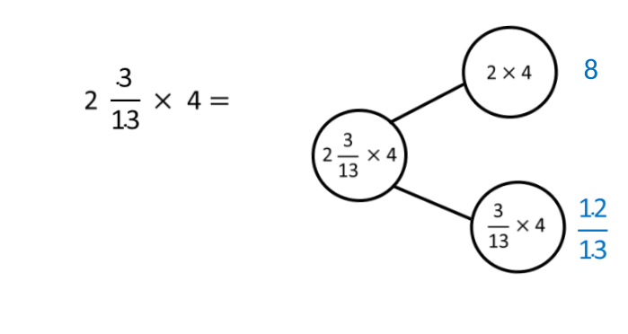
Multiplying fractions
When multiplying mixed numbers by integers (whole numbers). Partition the calculation like this:

Slide 24
Dividing fractions
When dividing fractions by integers (Year 6), children are taught to write the whole number as a fraction, flip it and then multiply.
E.g. 8/10 ÷ 5
8/10 ÷ 5/1
8/10 ÷ 1/5
8/10 x ⅕ = 8/50

Slide 25
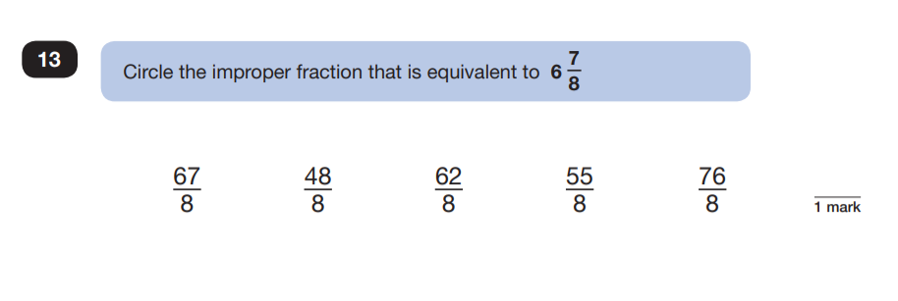
Past SATS questions

Slide 26
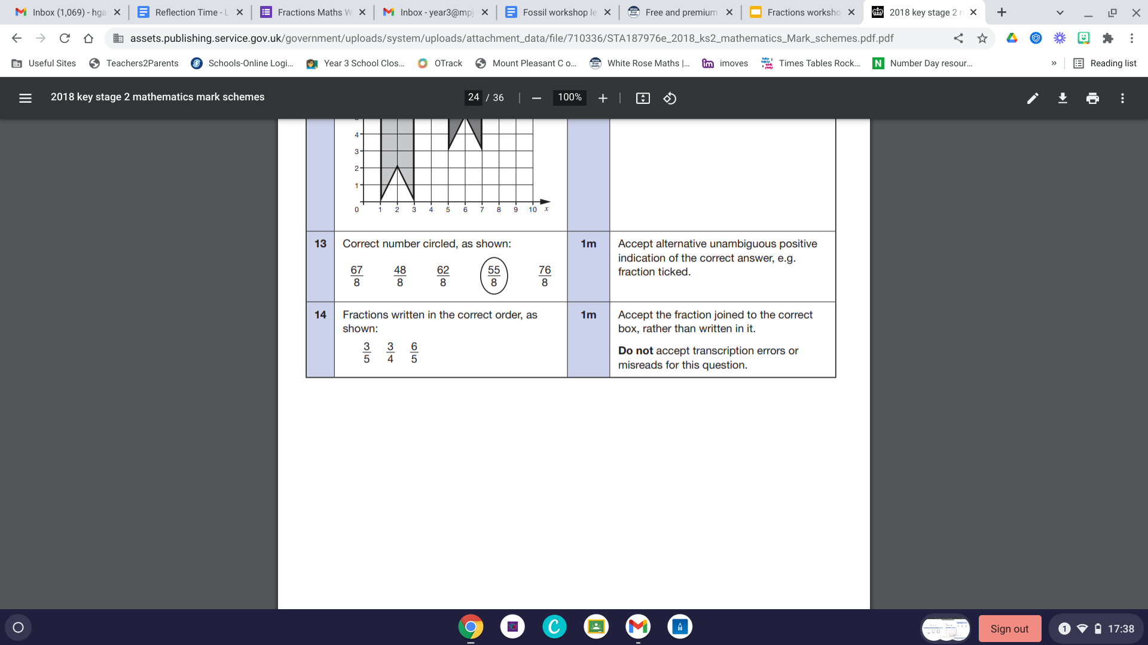
Past SATS questions

Slide 27
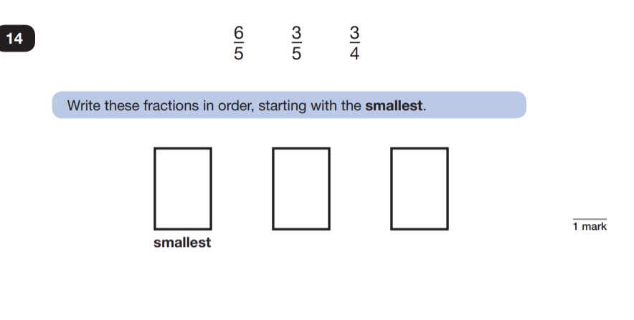
Past SATS questions

Slide 28
Past SATS questions

Slide 29
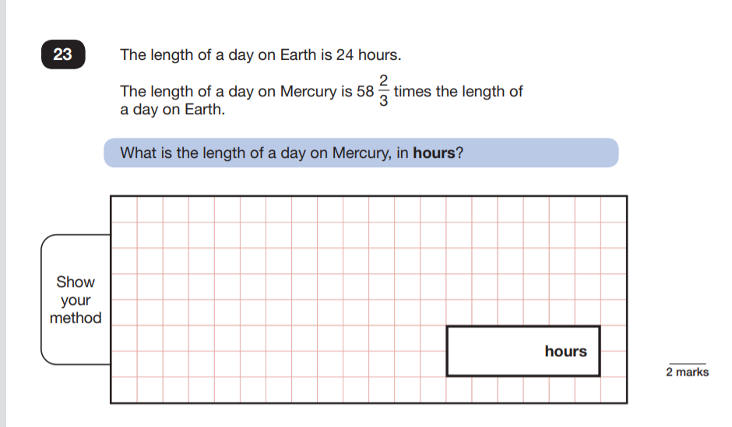
Past SATS questions

Slide 30
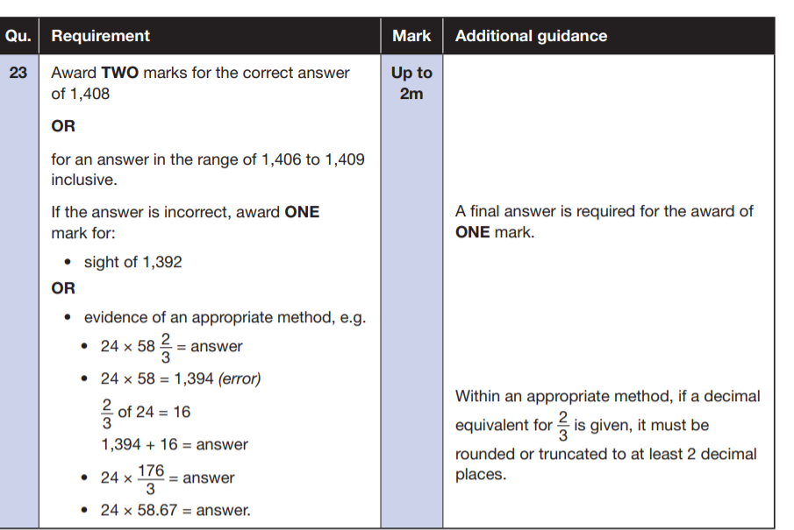
Past SATS questions

Slide 31
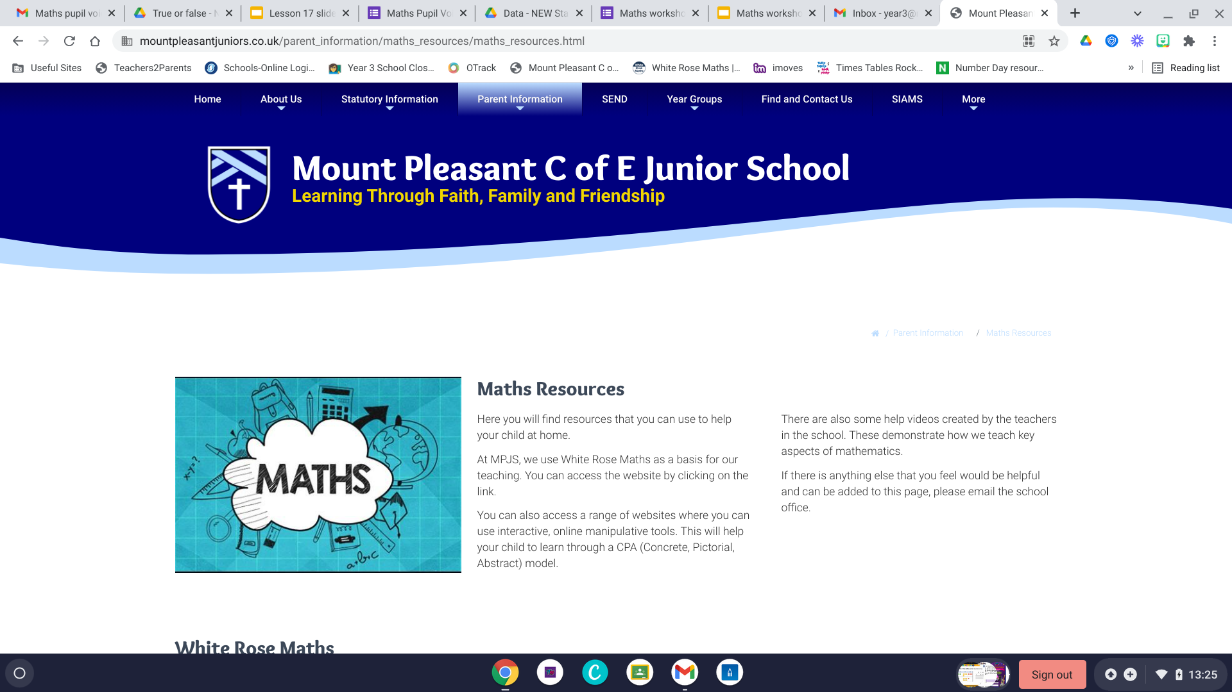
Maths resources on the website:
Parent information> maths resources
If there’s anything specific that you would like to know that I haven’t covered or you’re still not sure of, email me on year3@mpjs.eriding.net and I’ll add a ‘how to’ video onto this area of the website.

Slide 32
Need more help? See this useful website: https://thirdspacelearning.com/blog/how-to-teach-fractions-for-kids/

Slide 33
TT Rockstars competition Year 3 and 4

